Slide 1
Radio Systems
Pellissippi State
Applied Systems Development
Spring 2017

Slide 2
Introduction
Michelle

Slide 3
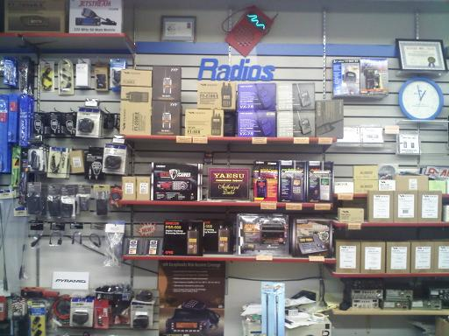
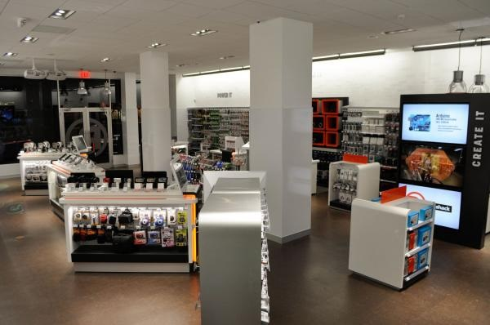
Radio Systems??

Slide 4
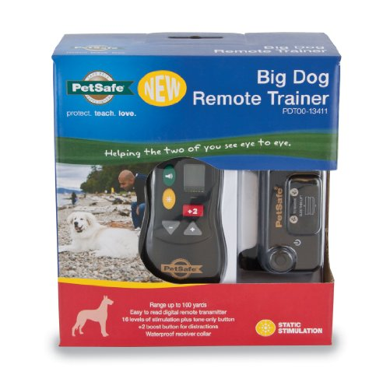


…Radio Systems

Slide 5
Company Facts: Locations:
Founded in 1991
Headquarters in Knoxville, TN
Initial IPO on Nasdaq in 1997
Now a Privately-Owned Multinational Corporation
Markets pet behavioral, containment, and lifestyle product solutions.
Last year, Radio Systems contributed more than $3,500,000 in volunteer support, grants, and product donations to organizations working to improve animal welfare or youth education.
Knoxville, Tennessee
Glen Allen, Virginia
Durham, North Carolina
Dundalk, Ireland
Chorley, United Kingdom
Shenzhen, China
Gold Coast, Australia

Slide 6
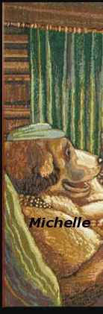

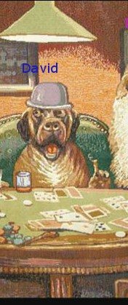
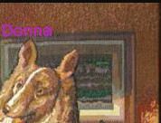
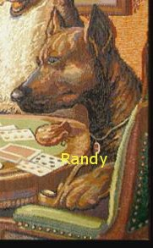

Team Radio Systems

Slide 7
Technology
Lessons We’ve Learned….So Far!
Donna

Slide 8
In The Beginning….
Xaml
Node.JS
.Net
Electron
XML

Slide 9

C# .NET !!

Slide 10
.NET!!
Toolbox
Drag
Drop
Style
Double-Click
Event-Handler/Code
Done!

Slide 11
But not ASP.Net, Web Forms, etc, but…
??
WPF
XAML

Slide 12
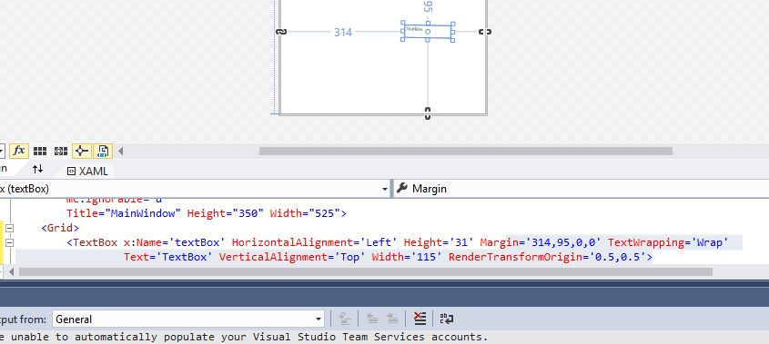
Drag & drop & move in Xaml

Slide 13
WPF
Advantages
Disadvantages
Feels more like real coding.
Provides the programmer more control over the precise outcome of the GUI.
Incorporates Setters much like CSS3 classes to allow styling of groups of controls to make them look uniform.
Has strong binding capability that allows easy access to resources.
Controls are hand-coded.
Setters are hand-coded.
Everything is hand-coded, except for some cool “data magic” that David will share with you later!!
The language is considered “fully-matured.” (in notes: tutorials are dated to previous versions of Visual Studio, opinions are set and widely-varying, it is hard to decipher the “correct” way of doing anything.

Slide 14
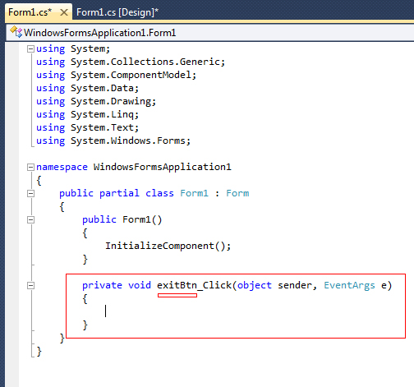

Architecture: Code Behind

Slide 15

Architecture: MVVM
Dependencies
Commands
Bindings
Triggers
Data Templates
Data Context
INotifyPropertyChanged

Slide 16

Wiki Walkthrough
Aaron

Slide 17
Signatures, PDFs & Emails
Randy

Slide 18

InkCanvas
WPF control/class that is used to capture ink strokes.
Input is stored as Stroke objects.
These objects will be stored with the rest of the client information.
Stroke objects will then be inserted into the PDF along with the rest of the client information.

Slide 19
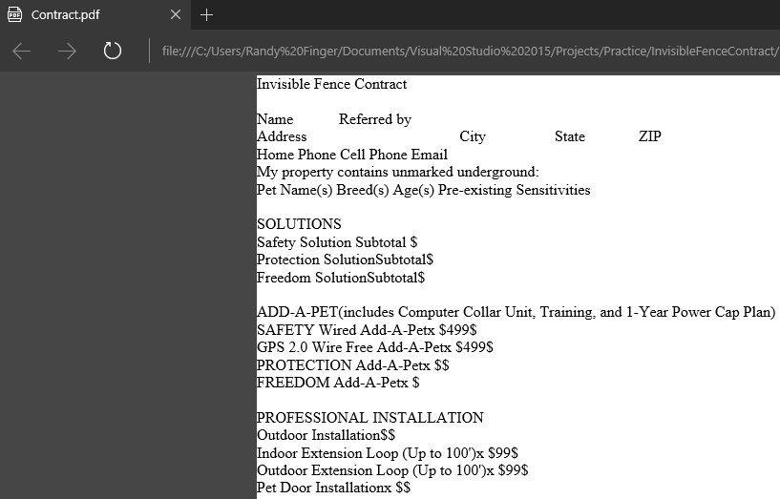
PDFsharp
PDFsharp is a .NET library that is used to create pdf files and allows you to control every line of text that is drawn.
PDFsharp version 1.32 is being used to create contract PDF.
PDFsharp has the ability to create pdf documents from text or image data.
Two possible approaches for application:
1. Create pdf using text data. Format the text to resemble contract.
2. Create view and populate with data. Create pdf from view image.
Current approach: Text data
PDFsharp allows different fonts, font sizes, font color, etc.

Slide 20
SendGrid
SendGrid is a cloud-based SMTP(Simple Mail Transfer Protocol) provider.
Client preference for sending email
Two ways to send email:
1. SMTP relay
2. Web API
Current approach: Web API
Client wants contract to be emailed to Radio Systems customer care center and to the client.

Slide 21



Data in Pieces
By David

Slide 22




Data Flow

Slide 23

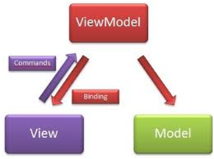
Architecture

Slide 24
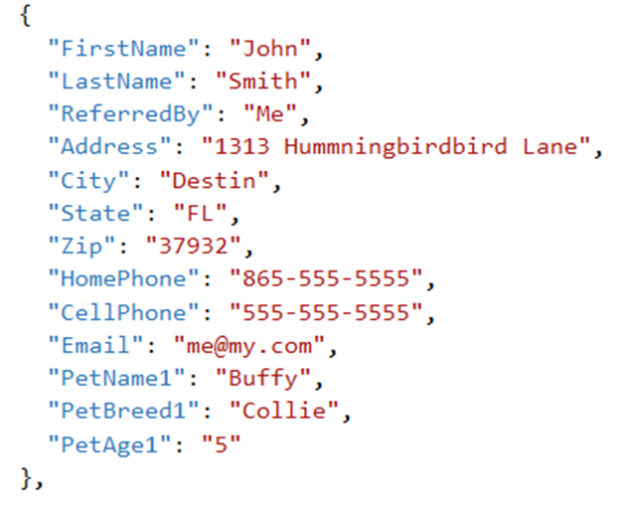
Incoming File

Slide 25
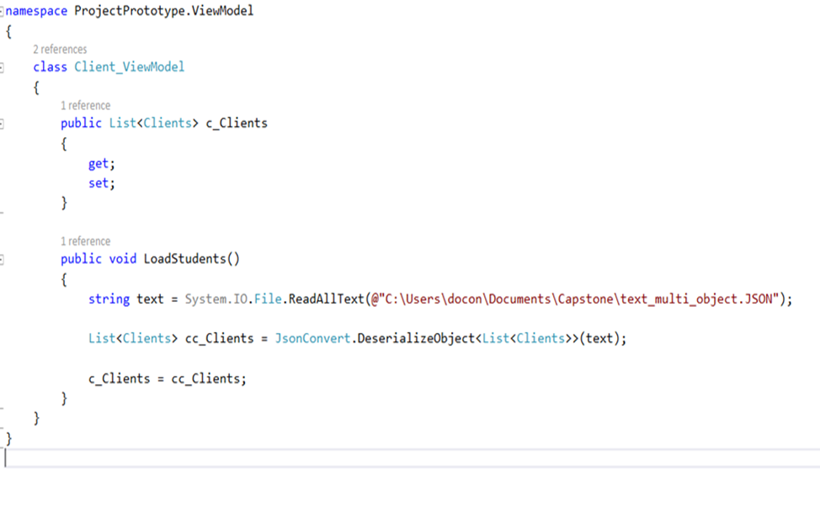
Code

Slide 26
Output
{
"FirstName": "John",
"LastName": "Smith",
"ReferredBy": "Me",
"Address": "1313 Hummningbirdbird Lane",
"City": "Destin",
"State": "FL",
"Zip": "37932",
"HomePhone": "865-555-5555",
"CellPhone": "555-555-5555",
"Email": "me@my.com",
"PetName1": "Lassie",
"PetBreed1": "Collie",
"PetAge1": "5"
},

